Slide 1
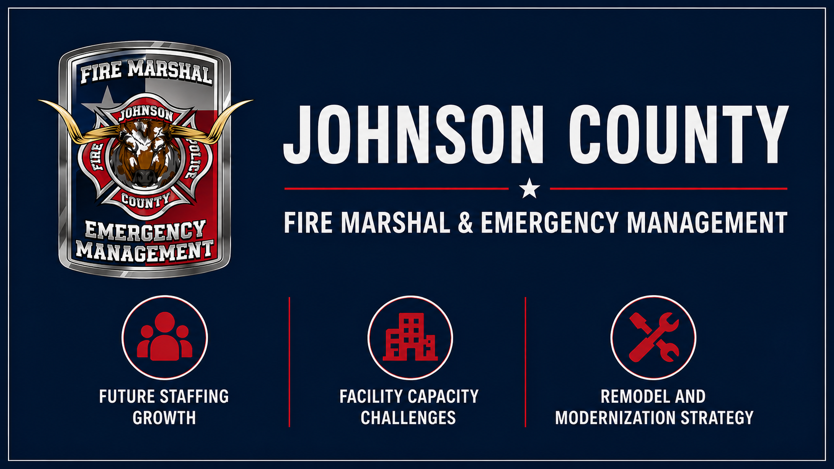

Slide 2

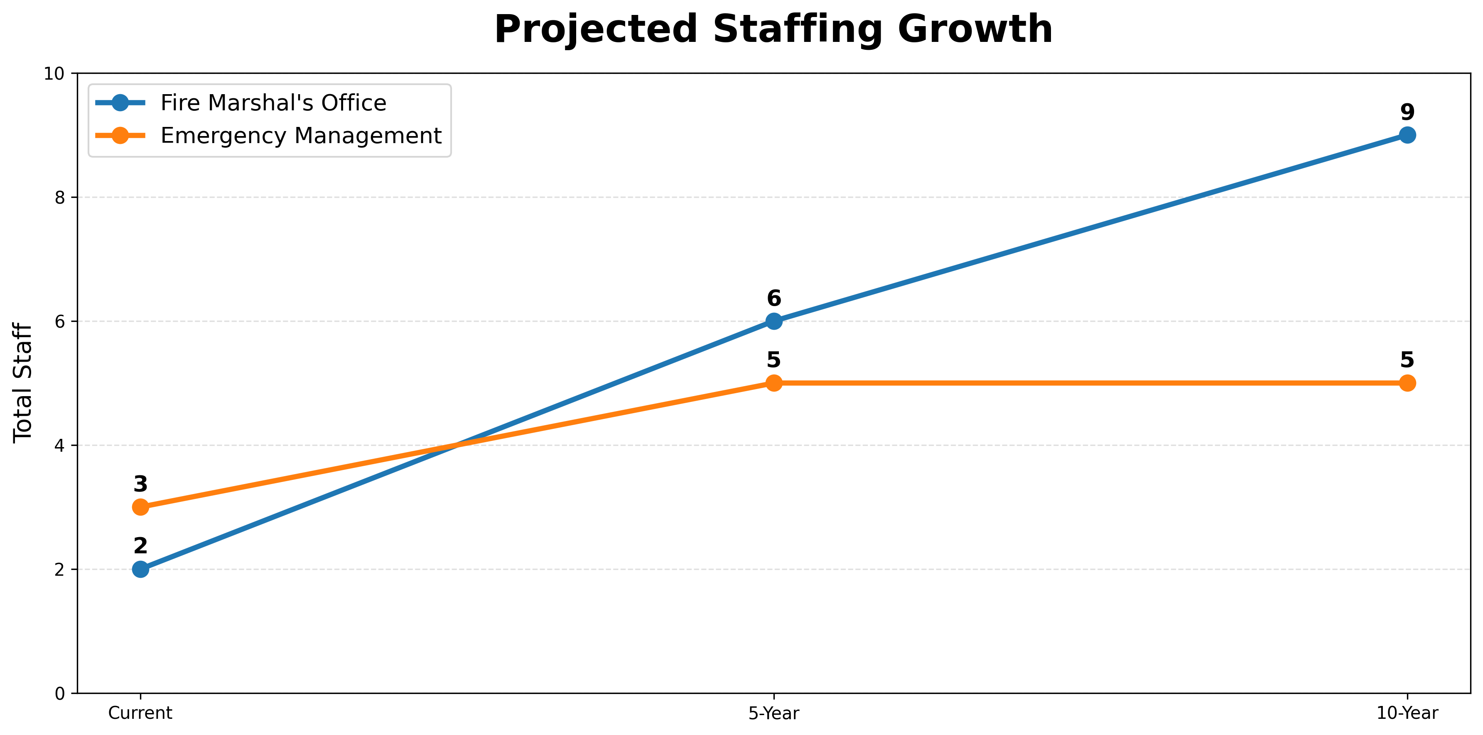
Key Message
The current facility was not designed for projected staffing and operational demands.
Strategic plans call for expanded services.
Staffing plans require additional workspace.
Remodeling now is more cost-effective than reacting later.

Slide 3
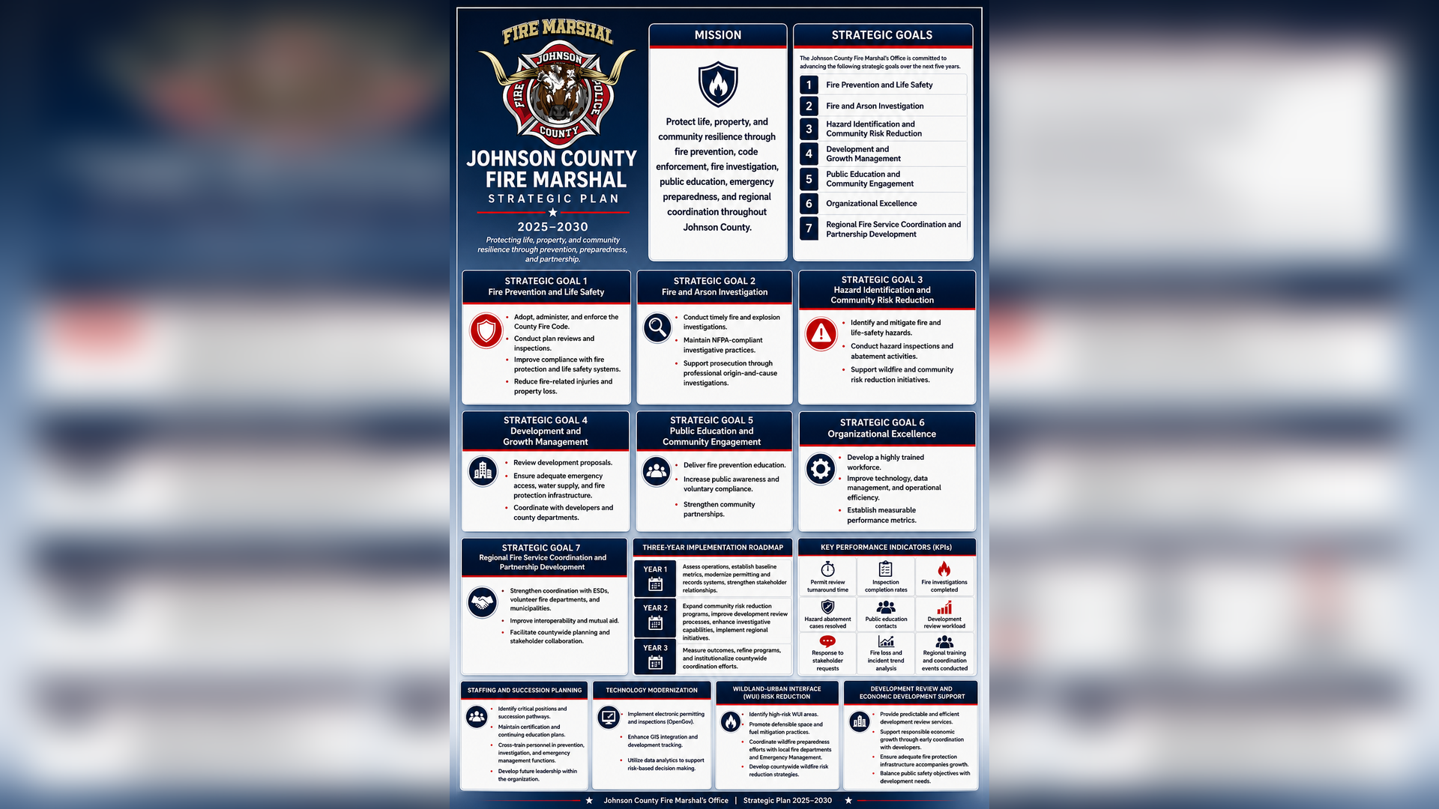

Slide 4
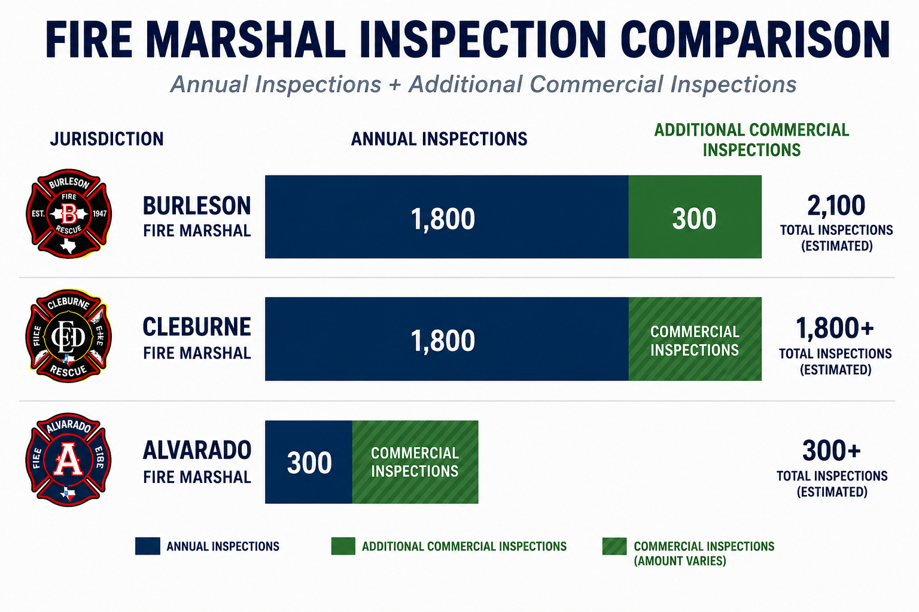
Inspection Benchmarking

Slide 5
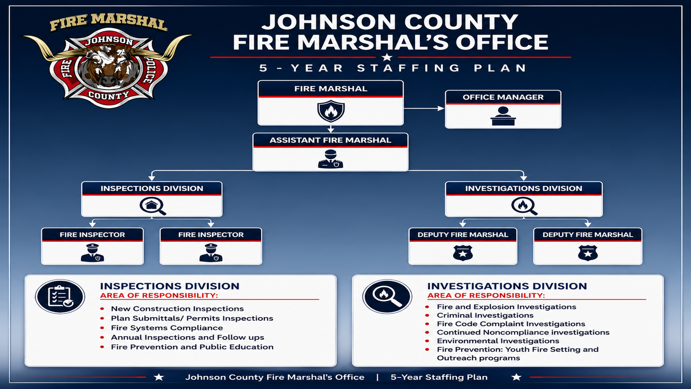

Slide 6
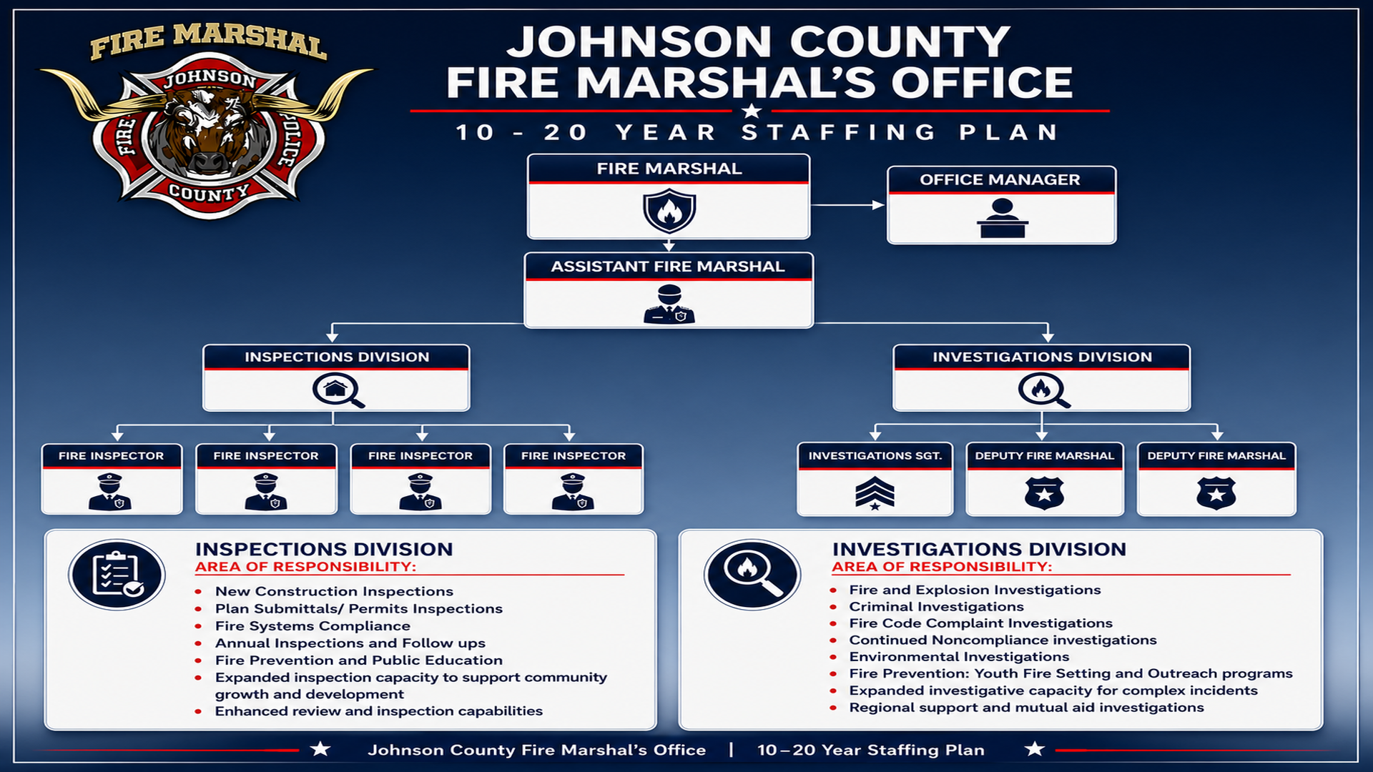

Slide 7
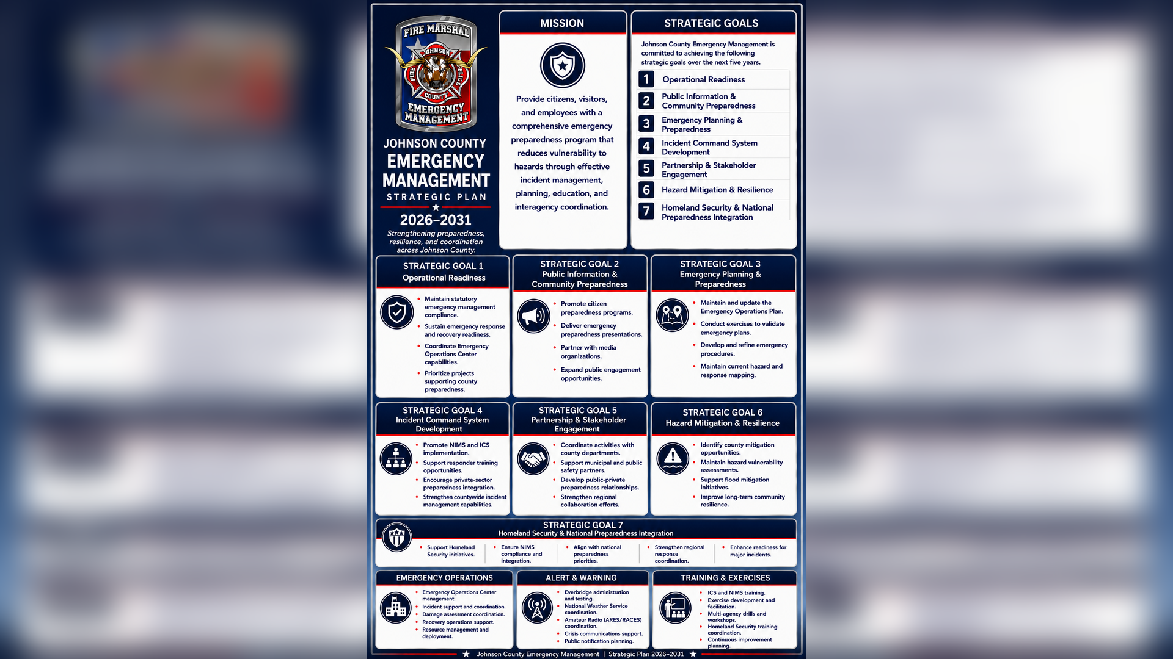

Slide 8
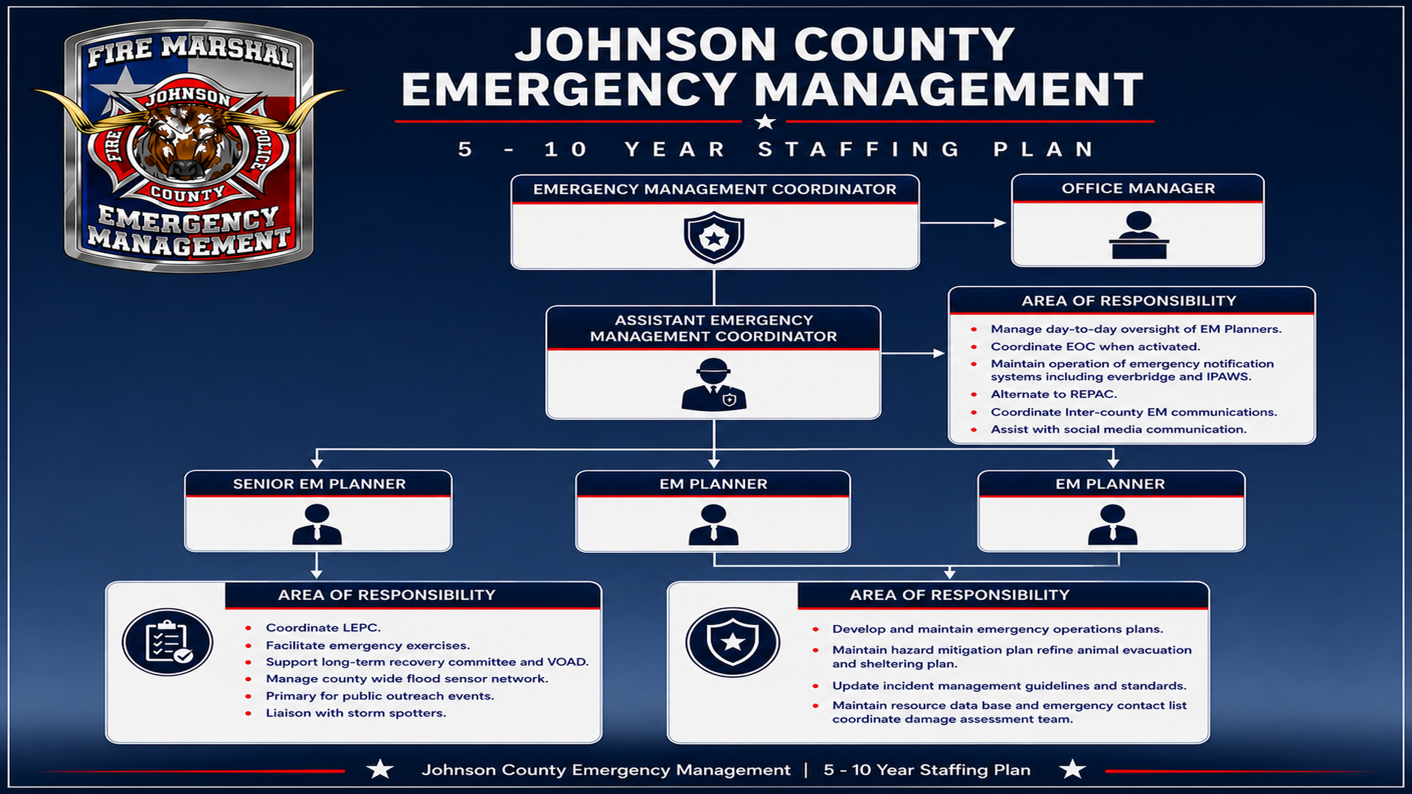

Slide 9
